Slide 1
Meeting Week 24
Last week summary
  System, model
Augmentation
  Issue stiffness matrix
  Description implementation
  New data
Outline ToDo next week

Slide 2


Slide 3


Slide 4
Initial problem
After initialization immediate blow up → factor 100 worse
Issue stiffness matrix K only positions for Theta (X, Theta, Y)
K = [0, 0, 0;
0, kb1+kb2, 0;
0, 0, 0]
Resulted in ANN correction accumulating over my simulation steps without demping

Slide 5
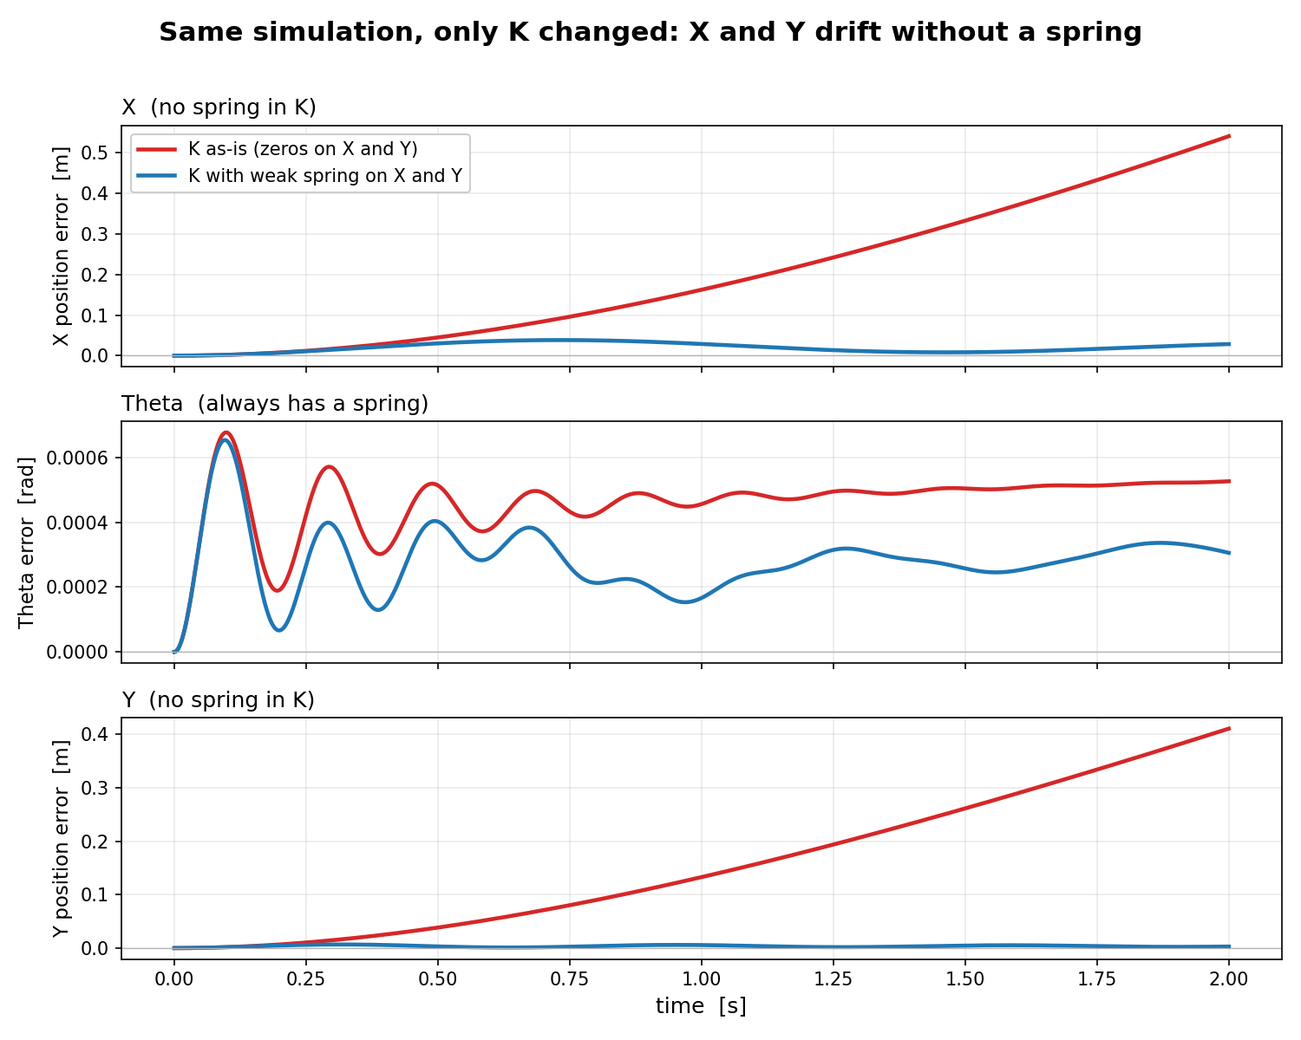
K = [0, 0, 0;
0, kb1+kb2, 0;
0, 0, 0]
Kb1+kb2 = 3975
Comparison:
K = [1000, 0, 0;
0, kb1+kb2, 0;
0, 0, 1000]
Open-loop run over full trajectory: sim-RMS
→ So only initial state
Notes:
Impuls input

Slide 6
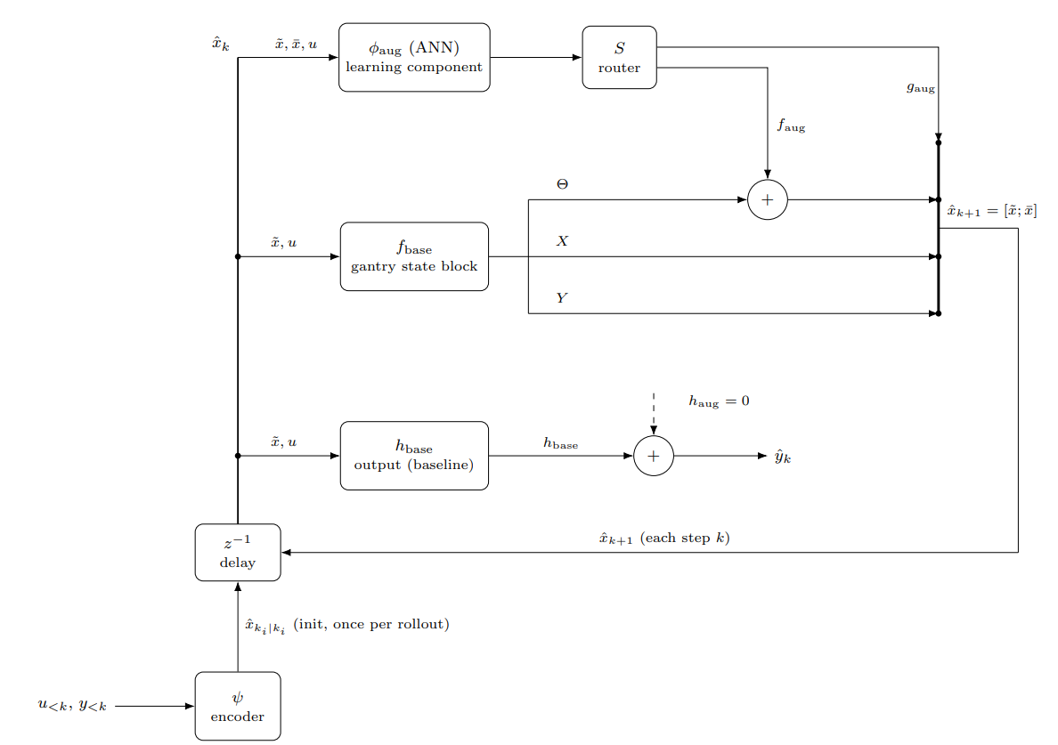

Slide 7
Only theta routing not sufficient
Model is coupled
For correct augmentation the ANN needs to be able to enter X and Y
  Due to coupling I need to be able to route the ANN through X and Y aswell (off-diagonal terms)

Slide 8
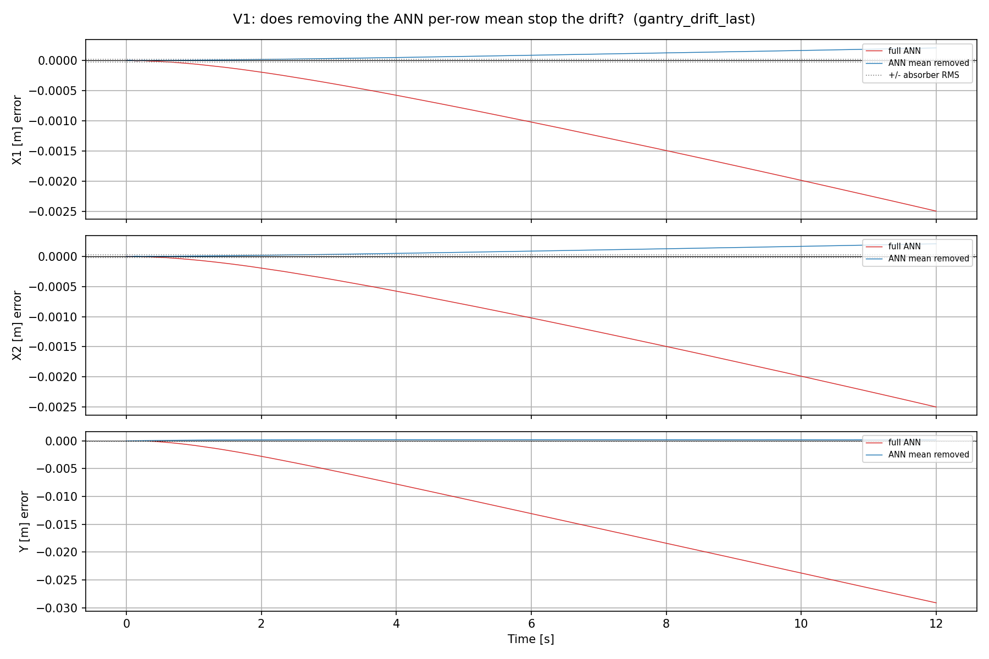
Drift with ANN
ANN creates:
  DC offset force added
Shows the error
Standstill trajectory at Y = 0.1 m with multisine 130-180hz
Notes:
Precisely, from the code: absorber_rms = data.val_x_aug[:, 0].std() — the standard deviation of the absorber's displacement δa over the V1 trajectory. That works out to ~2.19e-5 m ≈ 22 μm. It's plotted as two horizontal dotted lines at +22 μm and −22 μm (symmetric, because δa is a roughly zero-mean oscillation).What it represents: the hidden absorber (the 10%-mass MSD at 150 Hz) is exactly the unmodeled dynamics the augmentation exists to capture. Its displacement swings by ~22 μm RMS. So that band marks the scale of the thing the ANN should be learning.Why it's useful on an error plot: it turns the vertical axis into a "is this error meaningful?" yardstick:- Error inside the ±22 μm band → the residual is at absorber scale, i.e. the error is dominated by the very dynamics you're trying to model. That's the good regime.- Error outside the band → the error has grown beyond the signal itself, so it's no longer "unmodeled absorber," it's drift. On the untrained Y panel the ramp reaches ~110 μm ≈ 5× the band; on the trained figure the ANN reaches 2.6 cm ≈ 1000× the band. Both are "the error is now far bigger than the signal we care about.“
X and Y have no stiffness (K = 0). Their position is a free integrator — nothing pulls it back to a setpoint. (Physically: electric servo axes, no spring.)- Feed a constant force into such an axis: the velocity builds up to a terminal value (there's a little damping, so velocity itself stays bounded), but since that terminal velocity is nonzero and the position has no restoring stiffness, the position ramps forever. Constant force → constant drift rate → the curves you see (a short build-up, then a steady ramp to cm-scale).- Contrast with Theta (K > 0): there a constant force just produces a bounded position offset F/K — the spring balances the force and it settles. That's why Theta doesn't drift and X/Y do, under the same kind of ANN error.
So "DC-drift" = constant force × free integrator (no stiffness) = unbounded position growth. The stiffness is precisely what would stop it, and X/Y don't have it.
For your supervisor, the one-sentence version: the augmented model drifts because the ANN emits a small constant force on the stiffness-free X/Y axes, and a constant force on a free integrator integrates into unbounded position — proven by the fact that subtracting that constant removes the drift.
How it was trainedThe recipe (from the script's config):- Framework: Jan's SUBNET augmentation — the physics LPV-LFR gantry baseline in parallel with a small feedforward ANN (NX_ANN=2, 16 nodes, 2 layers, tanh) that adds corrections to the routed state rows. Encoder builds the initial state; training is windowed BPTT minimizing the nf-window simulation error with Adam.- Routing: full X+Θ+Y+absorber (0,1,2,3,4,5,6,7) — the deliverable routing, i.e. the ANN can write to the K=0 rows (that's what lets it drift).- Hyperparameters: lr = 1.49e-8, nf = 1400 (0.35 s window), 20 epochs, stride=100, validation on a cropped 8000-sample slice. Seed = cfg.seed + 3, mirroring Trial 3 of the Optuna search — the one config whose val sim-RMS actually moved past epoch 0 (6.58e-5 vs 8.01e-5), so its trained weights genuinely drift rather than staying at zero-init.- θ: nominal (joint_estimation=False) — free ANN on a correct physics baseline.- Data: the 14 noiseless augmentation simulation trajectories (standstill / ysweep / aprbs / lissajous), which contain the hidden 150 Hz MSD absorber the ANN is meant to learn.

Slide 9
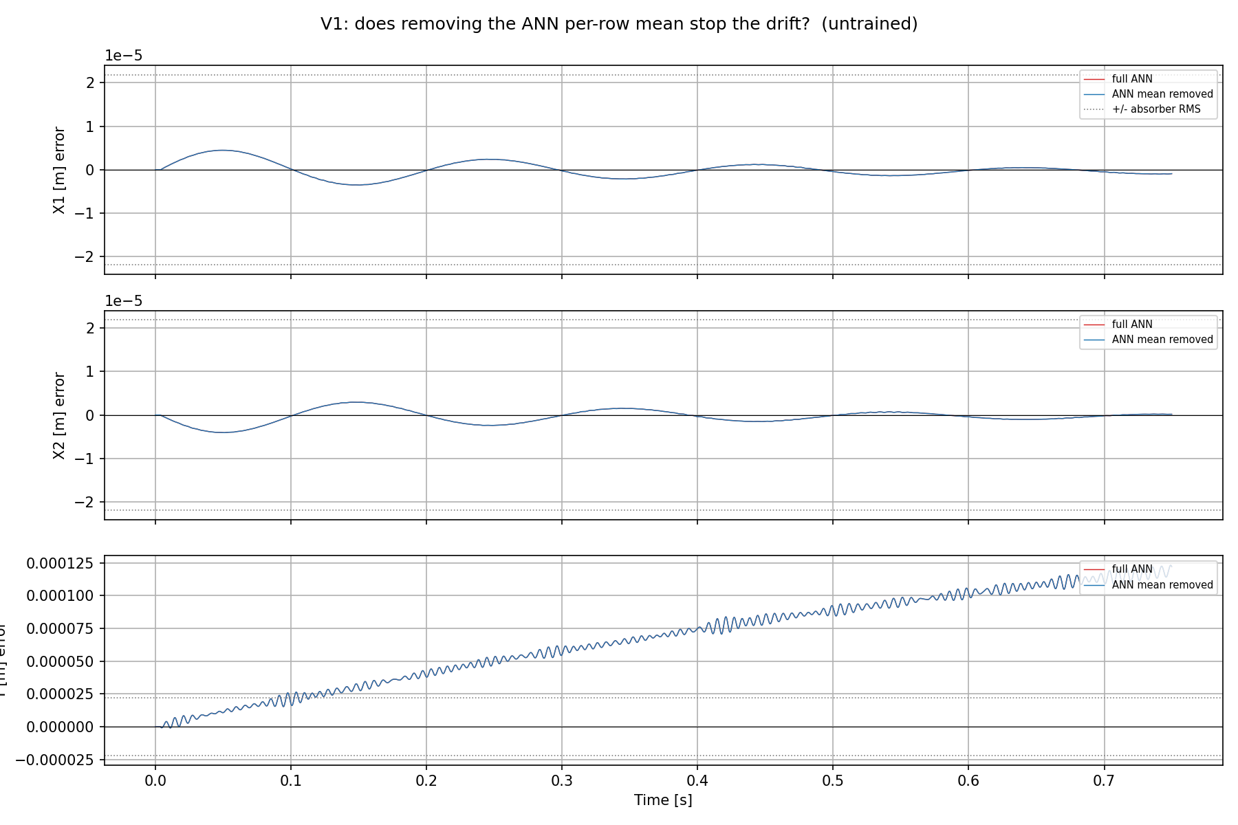
Drift with ANN
ANN at zero init:
  No DC offset force added
Shows the error
Standstill trajectory at Y = 0.1 m with multisine 130-180hz
Notes:
On the Y panel, look at the fine fast ripple riding on the ramp — that fast wiggle is the ~150 Hz content. It appears on Y specifically because the unmodeled absorber mass sits in the +Y direction (equilibrium offset L0 in +Y), so its mismatch imprints mainly on Y. Over 0.75 s that's ~110 cycles, so it reads as a dense ripple, not clean sinusoids.
"does removing the ANN's constant force stop the drift?" Untrained → the mean is ~0, so subtracting it changes nothing → it lies exactly on top of the red line (that overlap is the whole point of the control).
- "full ANN" (red): the free-run error using the ANN's complete output. Here (untrained) the ANN is zero-init, so this is effectively baseline + zero-ANN = the baseline free-run error.- "ANN mean removed" (blue): the counterfactual — the same free-run but with the ANN's per-row time-average (its DC/constant component) subtracted. This is the d6 test: "does removing the ANN's constant force stop the drift?" Untrained → the mean is ~0, so subtracting it changes nothing → it lies exactly on top of the red line (that overlap is the whole point of the control).- "+/- absorber RMS" (dotted horizontal lines at ±2.19e-5 m): the RMS of the absorber displacement — the scale of the signal the ANN is supposed to learn. It's a materiality yardstick: error inside the band is absorber-scale; the Y ramp climbing past it means the drift already exceeds the signal you care about.

Slide 11
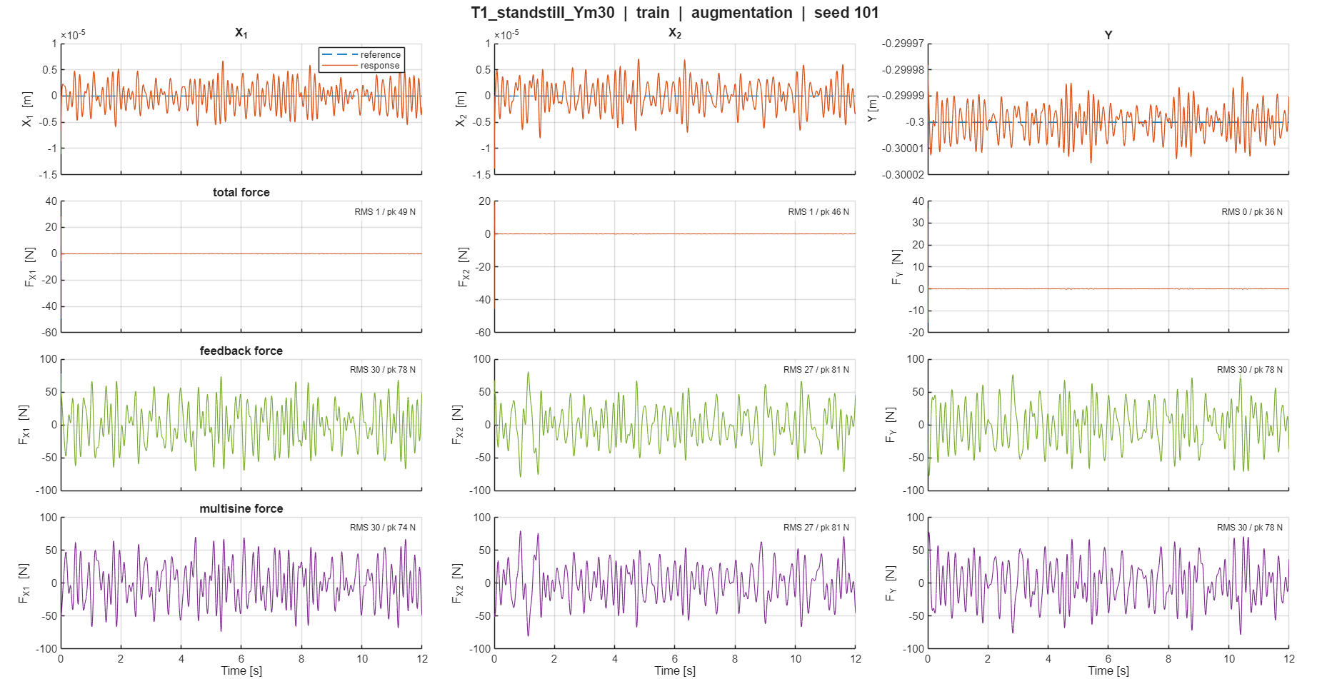

Slide 12
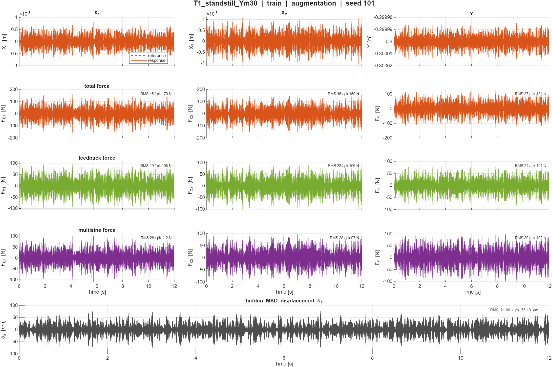

Slide 13
Loaded T1_standstill_Ym30.mat: N=48000
=== recorded total force u_total: RMS / peak per channel ===
chan with-MSD RMS with-MSD peak no-MSD RMS no-MSD peak
F_X1 45.313 169.432 0.719 49.142
F_X2 45.214 158.189 0.564 45.592
F_Y 36.444 133.651 0.439 36.362
absorber displacement RMS sigma(delta_a) = 2.196e-05 m
=== x0 at K0=17 (4.2 ms), with-MSD ===
state encoder true enc-true
X -1.82199e-06 -2.18042e-06 3.584e-07
Theta -1.35473e-05 -1.37761e-05 2.288e-07
Y -3.00001e-01 -3.00001e-01 -4.470e-07
dX -1.33925e-03 -2.16969e-03 8.304e-04
dTheta 1.22759e-02 1.02072e-02 2.069e-03
dY 6.88056e-03 6.90538e-03 -2.482e-05
encoder velocity error dv (X,Th,Y) = [ 8.30442412e-04 2.06868537e-03 -2.48202123e-05]
-> predicted settled K=0 offset tau_X*dvX=+1.284e-03 m tau_Y*dvY=-2.507e-05 m
two baseline free-runs (256s, 12.0 s each)
=== STAGE tail-mean [m] (last 20 %): E = R + enc_IC ===
chan E (total) R (absorber) enc_IC
X1 1.484e-03 3.164e-05 1.452e-03
X2 1.484e-03 3.164e-05 1.452e-03
Y 1.456e-04 3.800e-04 -2.344e-04
Saved: c:\Users\20203253\OneDrive - TU Eindhoven\Graduation Project\Baseline FP model\Baseline-LPV-Augmentation\simulations\gantry_subnet\diagnostics\d17_excitation.png
Saved: c:\Users\20203253\OneDrive - TU Eindhoven\Graduation Project\Baseline FP model\Baseline-LPV-Augmentation\simulations\gantry_subnet\diagnostics\d17_decomp_stage.png
Saved: c:\Users\20203253\OneDrive - TU Eindhoven\Graduation Project\Baseline FP model\Baseline-LPV-Augmentation\simulations\gantry_subnet\diagnostics\d17_decomp_logical.png
Saved: c:\Users\20203253\OneDrive - TU Eindhoven\Graduation Project\Baseline FP model\Baseline-LPV-Augmentation\simulations\gantry_subnet\diagnostics\d17_decomp_stage.npz
Notes:
d17

Slide 14
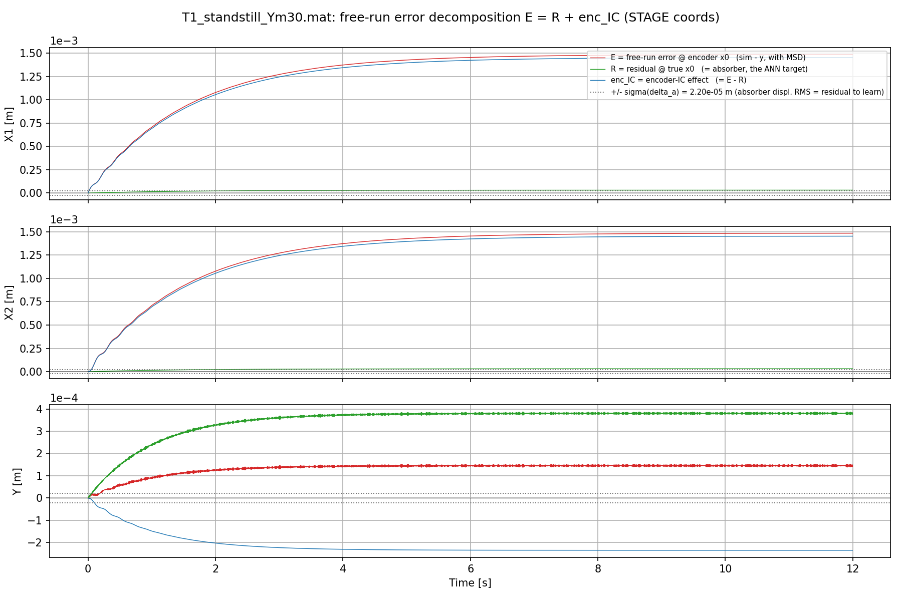

Slide 15
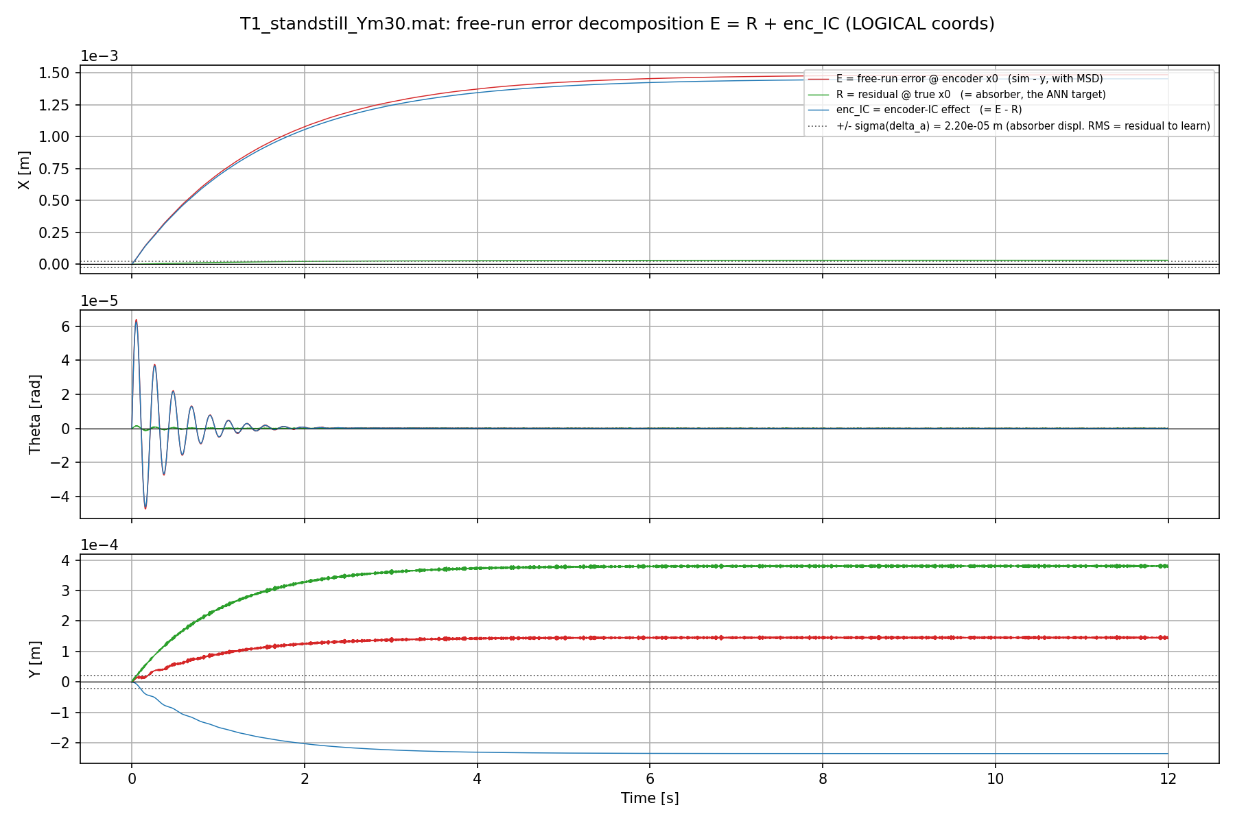

Slide 16
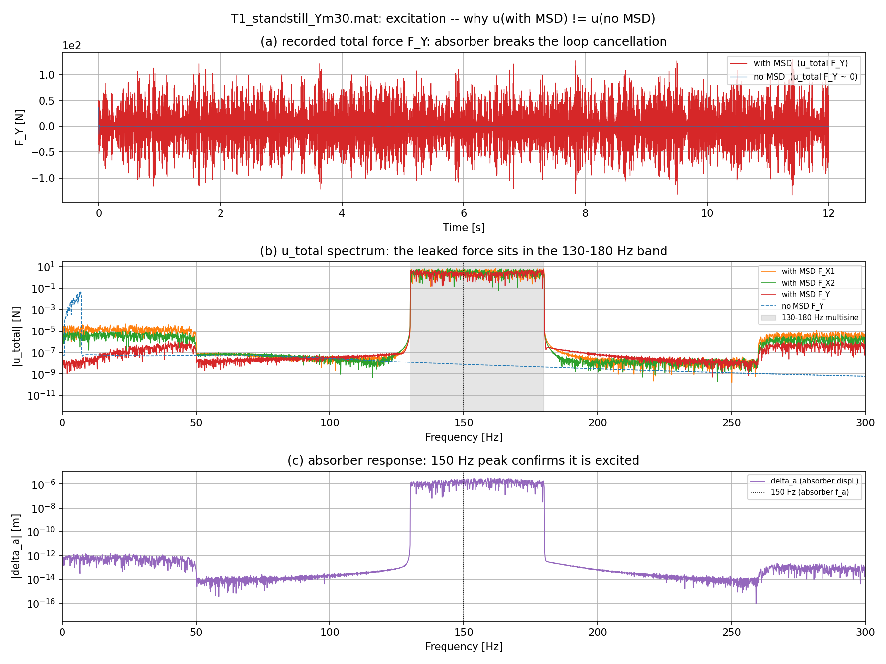

Slide 17
- Takeaway: the encoder x0 is the biggest untrained-free-run error and is fixable with measured ICs (supervisor's point); it is the bounded seed the ANN later turns into unbounded drift.

Slide 18
Conclusion issue:
Let me define it precisely, and reconcile it with Jan, because the reconciliation IS the definition. First a correction to my own earlier phrasing: I said the encoder x0 is "the seed the ANN turns into drift." That over-linked two things. The honest picture (from d11/d12 vs d17) is that they are two separate manifestations of one structural weakness, not a single chain. Here is the clean statement.The issue, definedOn the stiffness-free (K=0) X/Y axes, the rigid-body / DC direction (constant force → constant velocity) is left UNCONSTRAINED by the identification problem, and because these axes are free integrators with no restoring force, any persistent term parked in that direction accumulates without bound into position drift. It is an identifiability problem, not an energy problem.Two facts make that direction unconstrained, both measured:1. The zero-mean narrowband excitation carries no information about it (a constant force is orthogonal to the 130–180 Hz content), so it is unexcited.2. The 0.1 s windowed simulation loss cannot see its free-run consequence (a DC integrates to a negligible position change inside 0.1 s; the drift only appears past ~0.5 s), so it is loss-invisible.So nothing in the data or the loss pushes that direction toward zero. Two different things then leave a persistent term in it:- The encoder reconstructs velocity by differentiating the position window, which contains the 150 Hz absorber ripple, giving a biased initial velocity. In a free-run this settles to a bounded offset (τ·dv); it is the dominant untrained-baseline error (d17: 1.45e-3 m on X). Bounded, because it is a one-time IC error and damping stops it.- The trained ANN parks a DC force in that same direction. On the training distribution that DC is measured loss-neutral (d12), so the optimizer wanders into a nonzero value as a byproduct of fitting the real residual on the coupled rows. In a free-run that persistent DC acts every step and integrates to unbounded drift (d6: Y → −2.9 cm).The common amplifier for both is the K=0 free integrator: no stiffness, so a velocity-domain term becomes position drift. Neither is energy injection.Why this is exactly what Jan said (and where "something was missed")- "We don't expect drift from energy, the force should be zero-mean." Correct. The ideal residual is zero-mean, and the ANN's DC is not physics. It sits in a direction the training never constrains (loss-neutral, unexcited), so zero-mean is expected but never enforced, and the optimizer drifts off zero for free. This is an unidentifiable-direction problem, not an energy-balance violation.- "Solving it with an energy constraint is possible but not necessary." Correct. An energy/dissipativity constraint would suppress the symptom (forbid the DC), but the direct fix is to pin that one unconstrained direction (estimator-side regularization, the orthogonal-projection re-aim) and/or remove the encoder's contribution by using measured initial conditions. Both are cheaper and more targeted than a class-restricting energy constraint, which is why his "not necessary" is right.- "Maybe there's something we missed / not clearly communicated." Yes, two things. (1) The encoder does not receive velocities; it differentiates the position window, which amplifies the 150 Hz absorber ripple into a velocity bias on exactly the K=0 axes. (2) The windowed loss is blind to the DC's free-run consequence. In Jan's benchmarks (MSD, Bouc-Wen, cascaded tanks) every axis has stiffness, so an unconstrained DC just shifts the equilibrium by F/k and never drifts. The gantry's translational X/Y are the first stiffness-free axes his framework has met, and they are the first where leaving that direction unconstrained is catastrophic instead of harmless.One-sentence definitionThe drift is an identifiability failure on a marginally-stable axis: the constant-force / rigid-body direction of the K=0 X/Y integrators is both unexcited by the data and invisible to the short windowed loss, so it is never pinned to zero, and because there is no restoring stiffness, any persistent term left there (the encoder's velocity bias, bounded; or the ANN's loss-neutral DC, unbounded) integrates into position drift, not an energy or dissipation defect.---Summary- The issue is an identifiability problem, not energy: on the stiffness-free K=0 axes the DC/rigid-body direction is unexcited (zero-mean narrowband data) and loss-invisible (0.1 s window), so it is never constrained to zero, and the free integrator turns anything left there into drift.- Two measured manifestations of the same weakness: the encoder's velocity bias (bounded offset, d17) and the ANN's loss-neutral DC (unbounded drift, d6/d12). Common amplifier = the K=0 integrator.- This matches Jan exactly: the force should be zero-mean but the training never enforces it on that unconstrained direction; an energy constraint is possible but not necessary; the missed piece is that the encoder differentiates the position window and that translational X/Y have no stiffness (unlike all his benchmarks).- Correction to my earlier wording: the encoder offset (untrained) and the ANN DC (trained) are two manifestations of one structural weakness, not a strict cause→effect chain (d11/d12 show the DC is a loss-neutral byproduct on the training set, not an encoder-ramp compensation).- Non-energy fixes follow directly: measured ICs (removes the encoder term) and pinning the unconstrained direction (the orthogonal-projection re-aim). Want me to fold this definition into §1 of the drift doc?

Slide 19
Why this is exactly what Jan said (and where "something was missed")- "We don't expect drift from energy, the force should be zero-mean." Correct. The ideal residual is zero-mean, and the ANN's DC is not physics. It sits in a direction the training never constrains (loss-neutral, unexcited), so zero-mean is expected but never enforced, and the optimizer drifts off zero for free. This is an unidentifiable-direction problem, not an energy-balance violation.- "Solving it with an energy constraint is possible but not necessary." Correct. An energy/dissipativity constraint would suppress the symptom (forbid the DC), but the direct fix is to pin that one unconstrained direction (estimator-side regularization, the orthogonal-projection re-aim) and/or remove the encoder's contribution by using measured initial conditions. Both are cheaper and more targeted than a class-restricting energy constraint, which is why his "not necessary" is right.- "Maybe there's something we missed / not clearly communicated." Yes, two things. (1) The encoder does not receive velocities; it differentiates the position window, which amplifies the 150 Hz absorber ripple into a velocity bias on exactly the K=0 axes. (2) The windowed loss is blind to the DC's free-run consequence. In Jan's benchmarks (MSD, Bouc-Wen, cascaded tanks) every axis has stiffness, so an unconstrained DC just shifts the equilibrium by F/k and never drifts. The gantry's translational X/Y are the first stiffness-free axes his framework has met, and they are the first where leaving that direction unconstrained is catastrophic instead of harmless.

Slide 21
---Summary- (1) matters most because the encoder-init velocity bias is the dominant free-run error (~60× the absorber signal), so it corrupts the metric we judge models by, it is cheaply fixable with measured ICs (no ML, no energy constraint), and it is an observability issue specific to velocity on stiffness-free axes, the piece Jan's stiffness-only benchmarks never exposed.- (2) matters because the windowed loss cannot see or correct the DC, so training alone can never fix it (why more nf fails), and the objective is misaligned with the free-run goal, which points to the estimator-side pin.- Together: an error that is per-window recurring (1), loss-invisible (2), on an axis that cannot self-correct (K=0). Fix (1) now with measured ICs to remove the dominant term and clean the metric; fix (2) with the direction-pinning regularizer.
(1) The encoder does not receive velocities; it differentiates the position window, which amplifies the 150 Hz absorber ripple into a velocity bias on exactly the K=0 axes. (2) The windowed loss is blind to the DC's free-run consequence. In Jan's benchmarks (MSD, Bouc-Wen, cascaded tanks) every axis has stiffness, so an unconstrained DC just shifts the equilibrium by F/k and never drifts. The gantry's translational X/Y are the first stiffness-free axes his framework has met, and they are the first where leaving that direction unconstrained is catastrophic instead of harmless.
Do I have velocities in the real data?
  Check this.

Slide 22
---Summary- Correct: d17's R is the true-initial-state free-run, and it already shows true ICs remove the dominant encoder offset for the baseline (X 1.45e-3 → ~0). That half is measured and resolved.- But d17 is baseline-only (no ANN), so it does not test the trained drift. Whether true velocities fix the trained-ANN drift is still open.- Decisive next run: free-run a trained checkpoint from true x0 vs encoder x0 (small extension of d6). Still-drifts → needs the pin (d12); collapses → encoder was the seed (d9).- Shall I build it?

Slide 23
DC drift and
Encoder issue?
Log this in the literature index and treat it as the prong-2 reference. The single most useful follow-up is a primary-read of W-PGNN (2405.10429) to see whether its weighting can be re-pointed from state-density to the DC/frequency direction (our d16 target), since it is the closest in-framework tool. But the bigger point to carry to the meeting is that this review, comprehensive as it is, addresses only the ANN-DC half; the encoder-IC half we just measured (d17) is a separate, in-framework fix it does not cover. Want me to add a short entry noting this document and the prong-1/prong-2 split to the drift doc or the lit index?

Slide 24
Plots roland
Laten zien window increasen
En nf search

Slide 25
My leading hypothesis, to be confirmed by that shape, is the mechanism that actually supports the demonstration: at long nf the free-integrator error grows ~t² and dominates the loss, so the gradient is captured by the drift/DC direction (which the data cannot reduce), and the tiny narrowband 150 Hz absorber gradient gets swamped. If that is what is happening, then "doesn't learn at long nf" is itself evidence that the loss at long horizon is dominated by the unlearnable drift direction, which is exactly the C5/C6 story (the horizon that sees the drift is beyond where training can still learn the signal).

Slide 26
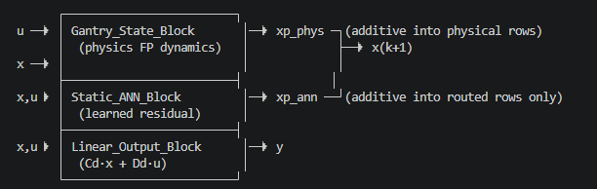

Slide 27
The issue, as I would state itExpectation (shared with Jan): a correct physics baseline plus a zero-mean residual should free-run at the absorber scale (~2.2e-5 m), bounded; and training an augmentation on it should only improve things.Observation: the untrained free-run misses that expectation by 60× (bounded), and every trained model misses it by more than the untrained one, with unbounded drift.The explanation (the issue): on the gantry's X/Y translational axes there is no stiffness, so they are free integrators, and on a free integrator the constant-force (DC) direction is special: any persistent term left there integrates into position drift, and nothing bounds it. Two independent things leave a persistent term there, and neither is constrained by the identification setup:

Slide 28
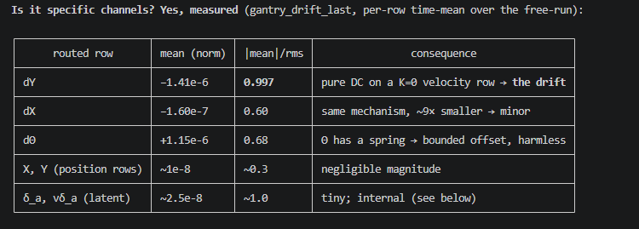

Slide 29
Zero mean fix?
The minimal fix is to enforce the zero-mean Jan already expects on the one unconstrained direction (the estimator-side pin)

Slide 30
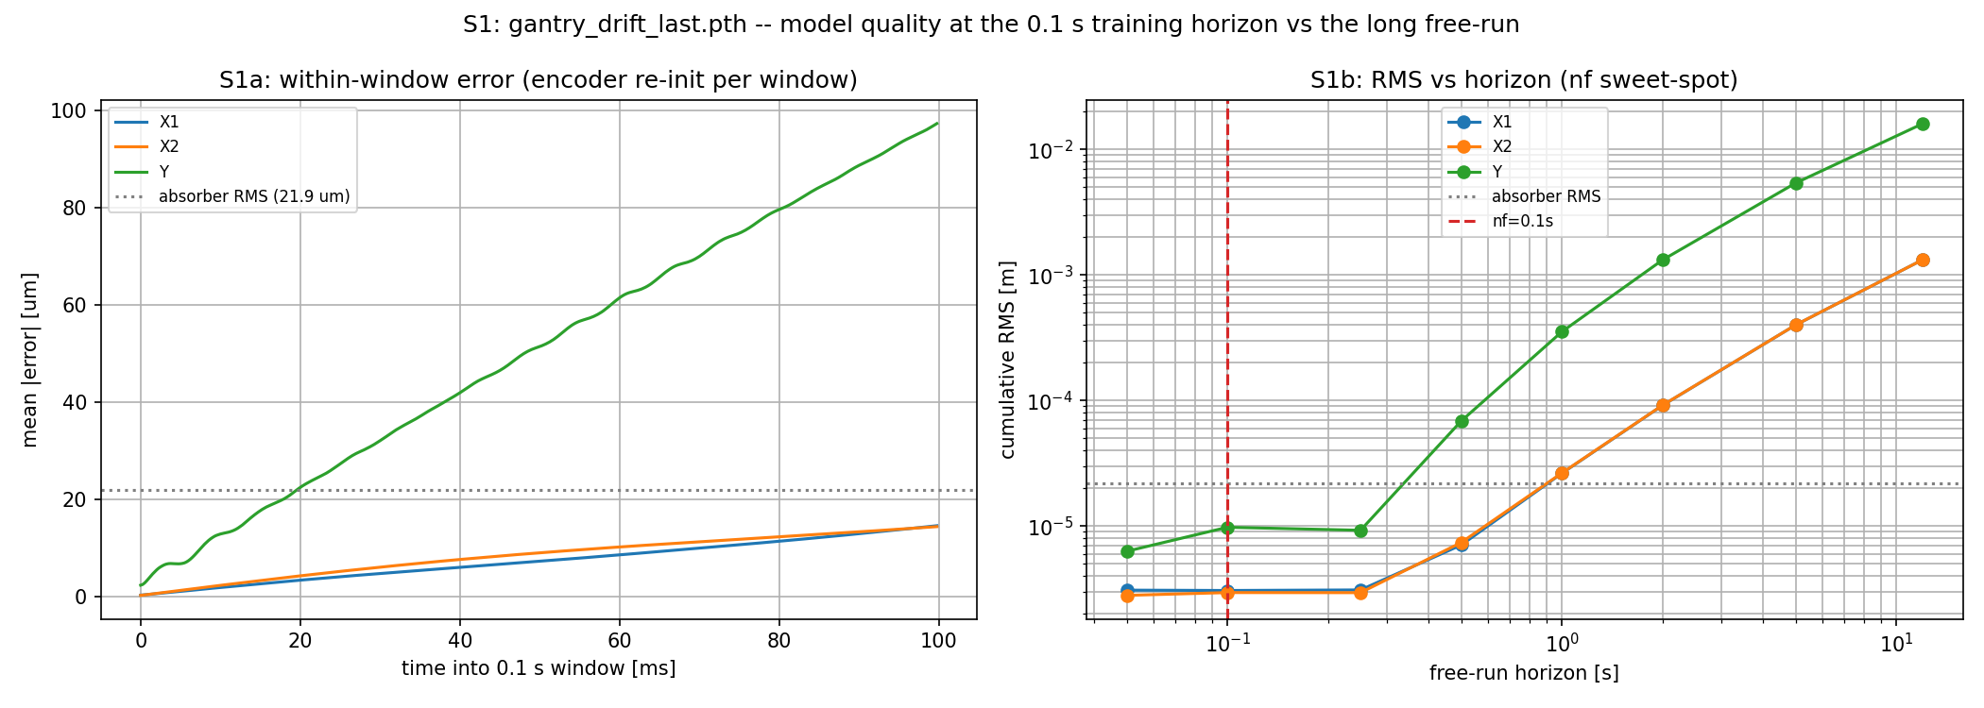
Drift with ANN
ANN at zero init
No DC offset force added
Standstill trajectory at Y = 0.1 m
Notes:
Title: model quality at the 0.1 s training horizon vs the long free-run (on the drifted checkpoint). Two panels:Left (S1a) — within a single 0.1 s window (encoder re-initialized each window, exactly as training does). X-axis is time into the window (0-100 ms), Y-axis is mean |error| in μm:- Y (green) ramps to ~97 μm by the window end, crossing the absorber-RMS line (21.9 μm) at ~18 ms.- X1/X2 (blue/orange) stay small, ~14 μm, below the absorber line.- So the drift ramp on Y begins immediately even inside the 0.1 s window — but because the training loss is an RMS pooled over all channels (and the ramp is 0 at the window start), it averages down to the ~30 μm nf-RMS that training reports as "fine." That's the subtlety: the drift is present in-window but RMS-diluted.Right (S1b) — cumulative RMS vs free-run horizon (log-log, 0.05 s to 12 s), the key panel:- All channels are flat at/below absorber level (~1e-5 m) out to ~0.25 s. The red dashed line marks the training horizon nf = 0.1 s — it sits squarely in that flat region.- Past ~0.5 s the Y (green) curve ramps steeply to ~2e-2 m (2 cm) by 12 s; X1/X2 to ~7e-4 m.- The message: at the horizon you train on, the model is genuinely good. The drift only enters at ~0.5 s and grows 1000× by 12 s. There is no nf in the flat region that would let the loss "see" it — which is exactly the motivation for your nf-curriculum (push nf past the 0.5 s onset).

Slide 31
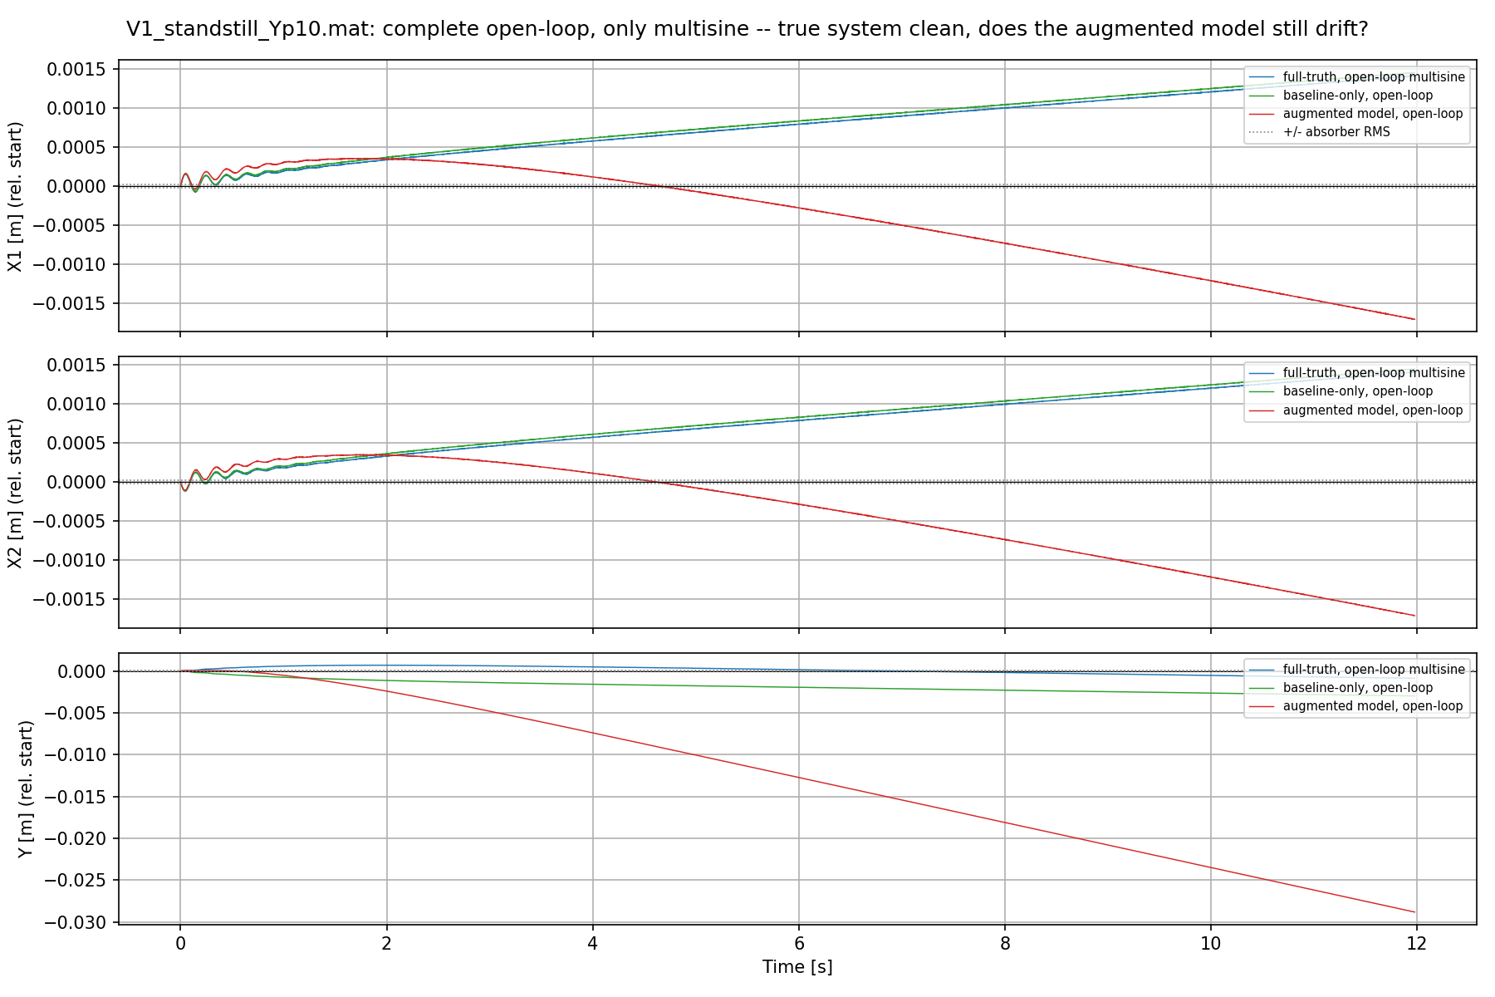
Drift with ANN
ANN at zero init
No DC offset force added
Standstill trajectory at Y = 0.1 m

Slide 32
Question
To counter act the drift implement closed-loop training, would a trained model in closed-loop be acceptable?
  Will need a metric to determine that closed-loop doesn’t hide a bad model

Slide 33
New data
Frozen-Y standstills, Y-sweeps, randomized jerk-limited setpoint sequences (amplitude ladder), Lissajous
Excitation: reference trajectories (operating-range coverage) + injected random-phase multisine force

Slide 34
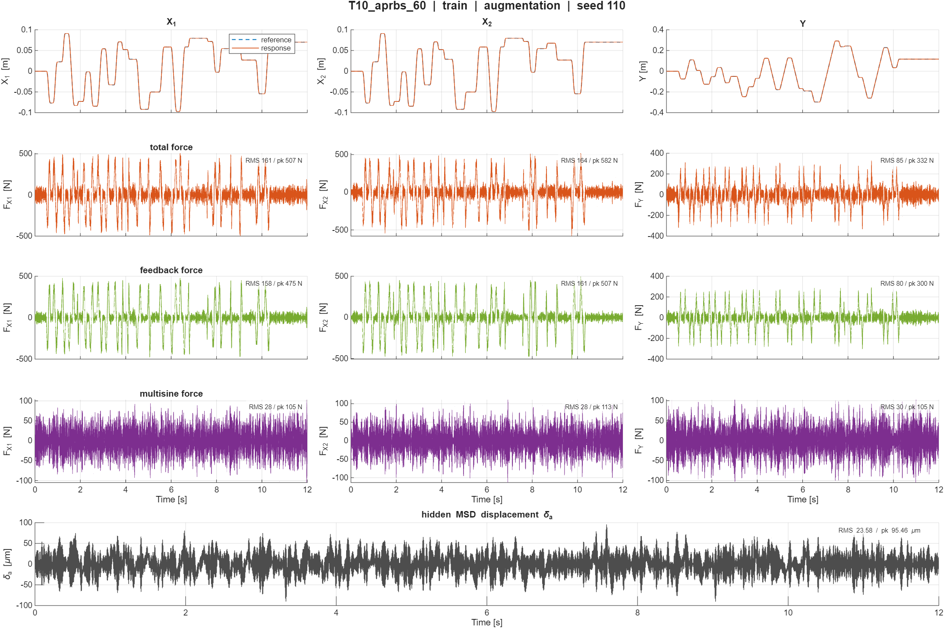

Slide 36
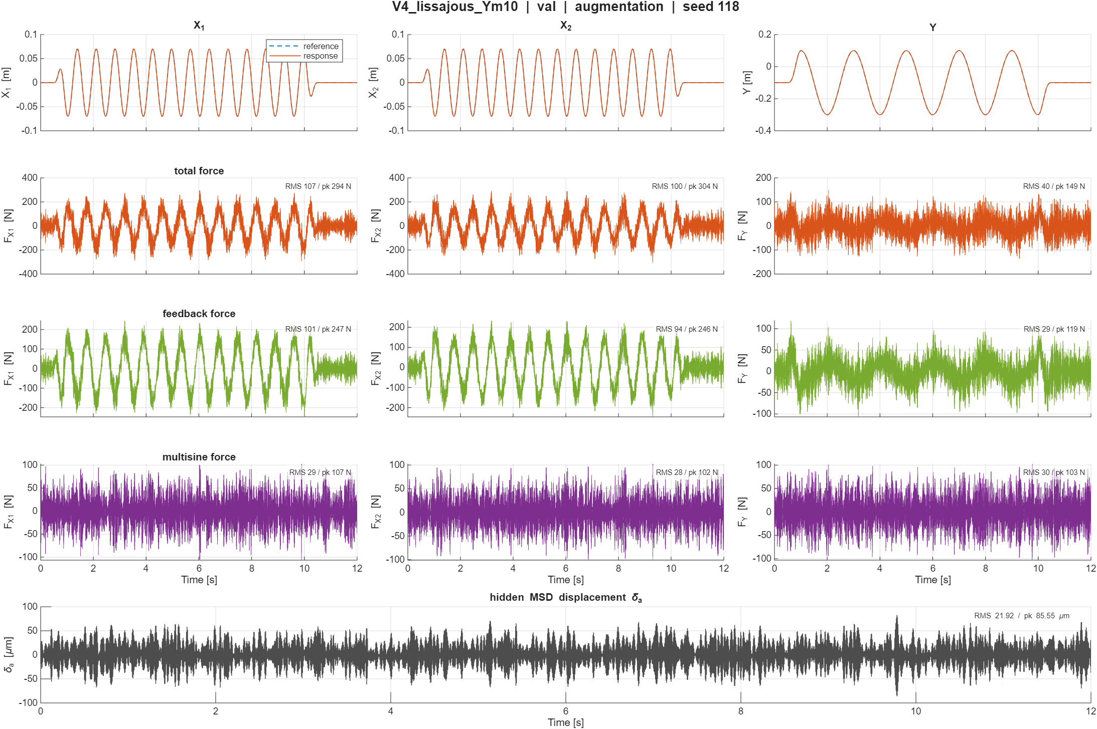

Slide 37
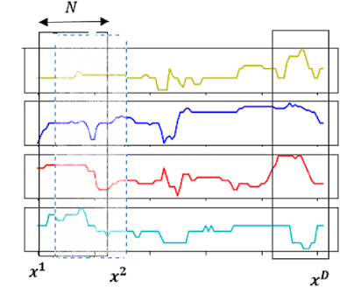
Runtime
Stride
DeepSI allows to pass stride
  So we see all the data but with less overlap, let initializations of the encoder (initial state)

Slide 38
Real data – Parameter recovery
Train the initial parameter recovery for simulation on real data
  ILC data from Quinten
Updated parameters from telica datasheet
Trained in open-loop to find correct parameters
  Model used to train not adjusted for noise

Slide 39
[Training]
Traj RMS [m] X1 [m] X2 [m] Y [m]
------ ------------ ---------- ---------- ----------
T1a 1.0278e-02 7.8897e-03 7.9198e-03 1.3854e-02
T1b 1.0179e-02 7.1000e-03 7.1167e-03 1.4484e-02
T2a 1.0425e-02 7.6775e-03 7.8229e-03 1.4350e-02
T2b 1.0108e-02 7.8706e-03 8.0148e-03 1.3429e-02
T3a 1.2772e-02 8.4240e-03 8.4017e-03 1.8649e-02
T3b 2.2566e-02 2.4486e-02 2.4589e-02 1.7984e-02
T4a 1.8198e-02 7.4397e-03 7.3111e-03 2.9744e-02
T4b 1.6969e-02 6.3381e-03 6.1577e-03 2.8032e-02
T5a 1.0699e-02 7.9299e-03 7.7116e-03 1.4869e-02
T5b 1.0172e-02 7.7147e-03 7.4889e-03 1.3958e-02
T6a 1.2646e-02 7.7092e-03 7.4137e-03 1.9115e-02
T6b 1.1224e-02 7.0284e-03 6.7469e-03 1.6823e-02
T7a 1.6774e-02 7.0461e-03 6.6075e-03 2.7401e-02
T7b 1.3988e-02 6.8615e-03 6.5954e-03 2.2280e-02
T8a 9.8579e-03 8.1010e-03 8.6607e-03 1.2284e-02
T8b 9.8908e-03 7.7692e-03 8.2593e-03 1.2842e-02
T9a 2.3249e-02 1.5228e-02 1.5080e-02 3.4092e-02
T9b 3.0895e-02 2.4128e-02 2.3759e-02 4.1435e-02
T10a 1.4098e-02 8.9915e-03 9.5564e-03 2.0593e-02
T10b 1.5222e-02 9.1323e-03 9.7337e-03 2.2737e-02
T11a 4.5063e-02 1.7206e-02 1.6857e-02 7.4241e-02
T11b 1.7571e-02 8.7547e-03 9.2209e-03 2.7650e-02
Train RMSE: 1.803067e-02 m
============================================================
Structural validation [T1a] [baseline]
============================================================
Ch RMS [m] NRMSE [%] Verdict
---- -------------- ---------- ------------
X1 6.5460e-02 432.39 POOR (>30%)
X2 6.5747e-02 434.29 POOR (>30%)
Y 1.9215e-01 619.21 POOR (>30%)

Slide 40
============================================================
Structural validation [E1T] [baseline]
============================================================
Ch RMS [m] NRMSE [%] Verdict
---- -------------- ---------- ------------
X1 5.5048e-02 369.82 POOR (>30%)
X2 5.7693e-02 387.58 POOR (>30%)
Y 1.6479e-01 539.51 POOR (>30%)
[Test]
Traj RMS [m] X1 [m] X2 [m] Y [m]
------ ------------ ---------- ---------- ----------
E1a 1.4654e-02 7.4511e-03 7.1043e-03 2.3199e-02
E1b 1.3790e-02 7.4265e-03 7.0890e-03 2.1566e-02
E1T 1.2968e-02 7.3519e-03 7.0225e-03 2.0028e-02
E2a 8.9338e-03 6.6624e-03 6.7226e-03 1.2242e-02
E2b 1.0298e-02 8.3752e-03 8.4803e-03 1.3270e-02
E2T 1.2320e-02 1.0815e-02 1.1022e-02 1.4727e-02
Test RMSE: 1.232001e-02 m

Slide 41
Orthogonality
Due to drift best epoch 0
Can’t currently show improvement due to the drift off

Slide 42
Outline next week
Find solution for drift during training
Workout orthogonality with the drift fixed

Slide 43
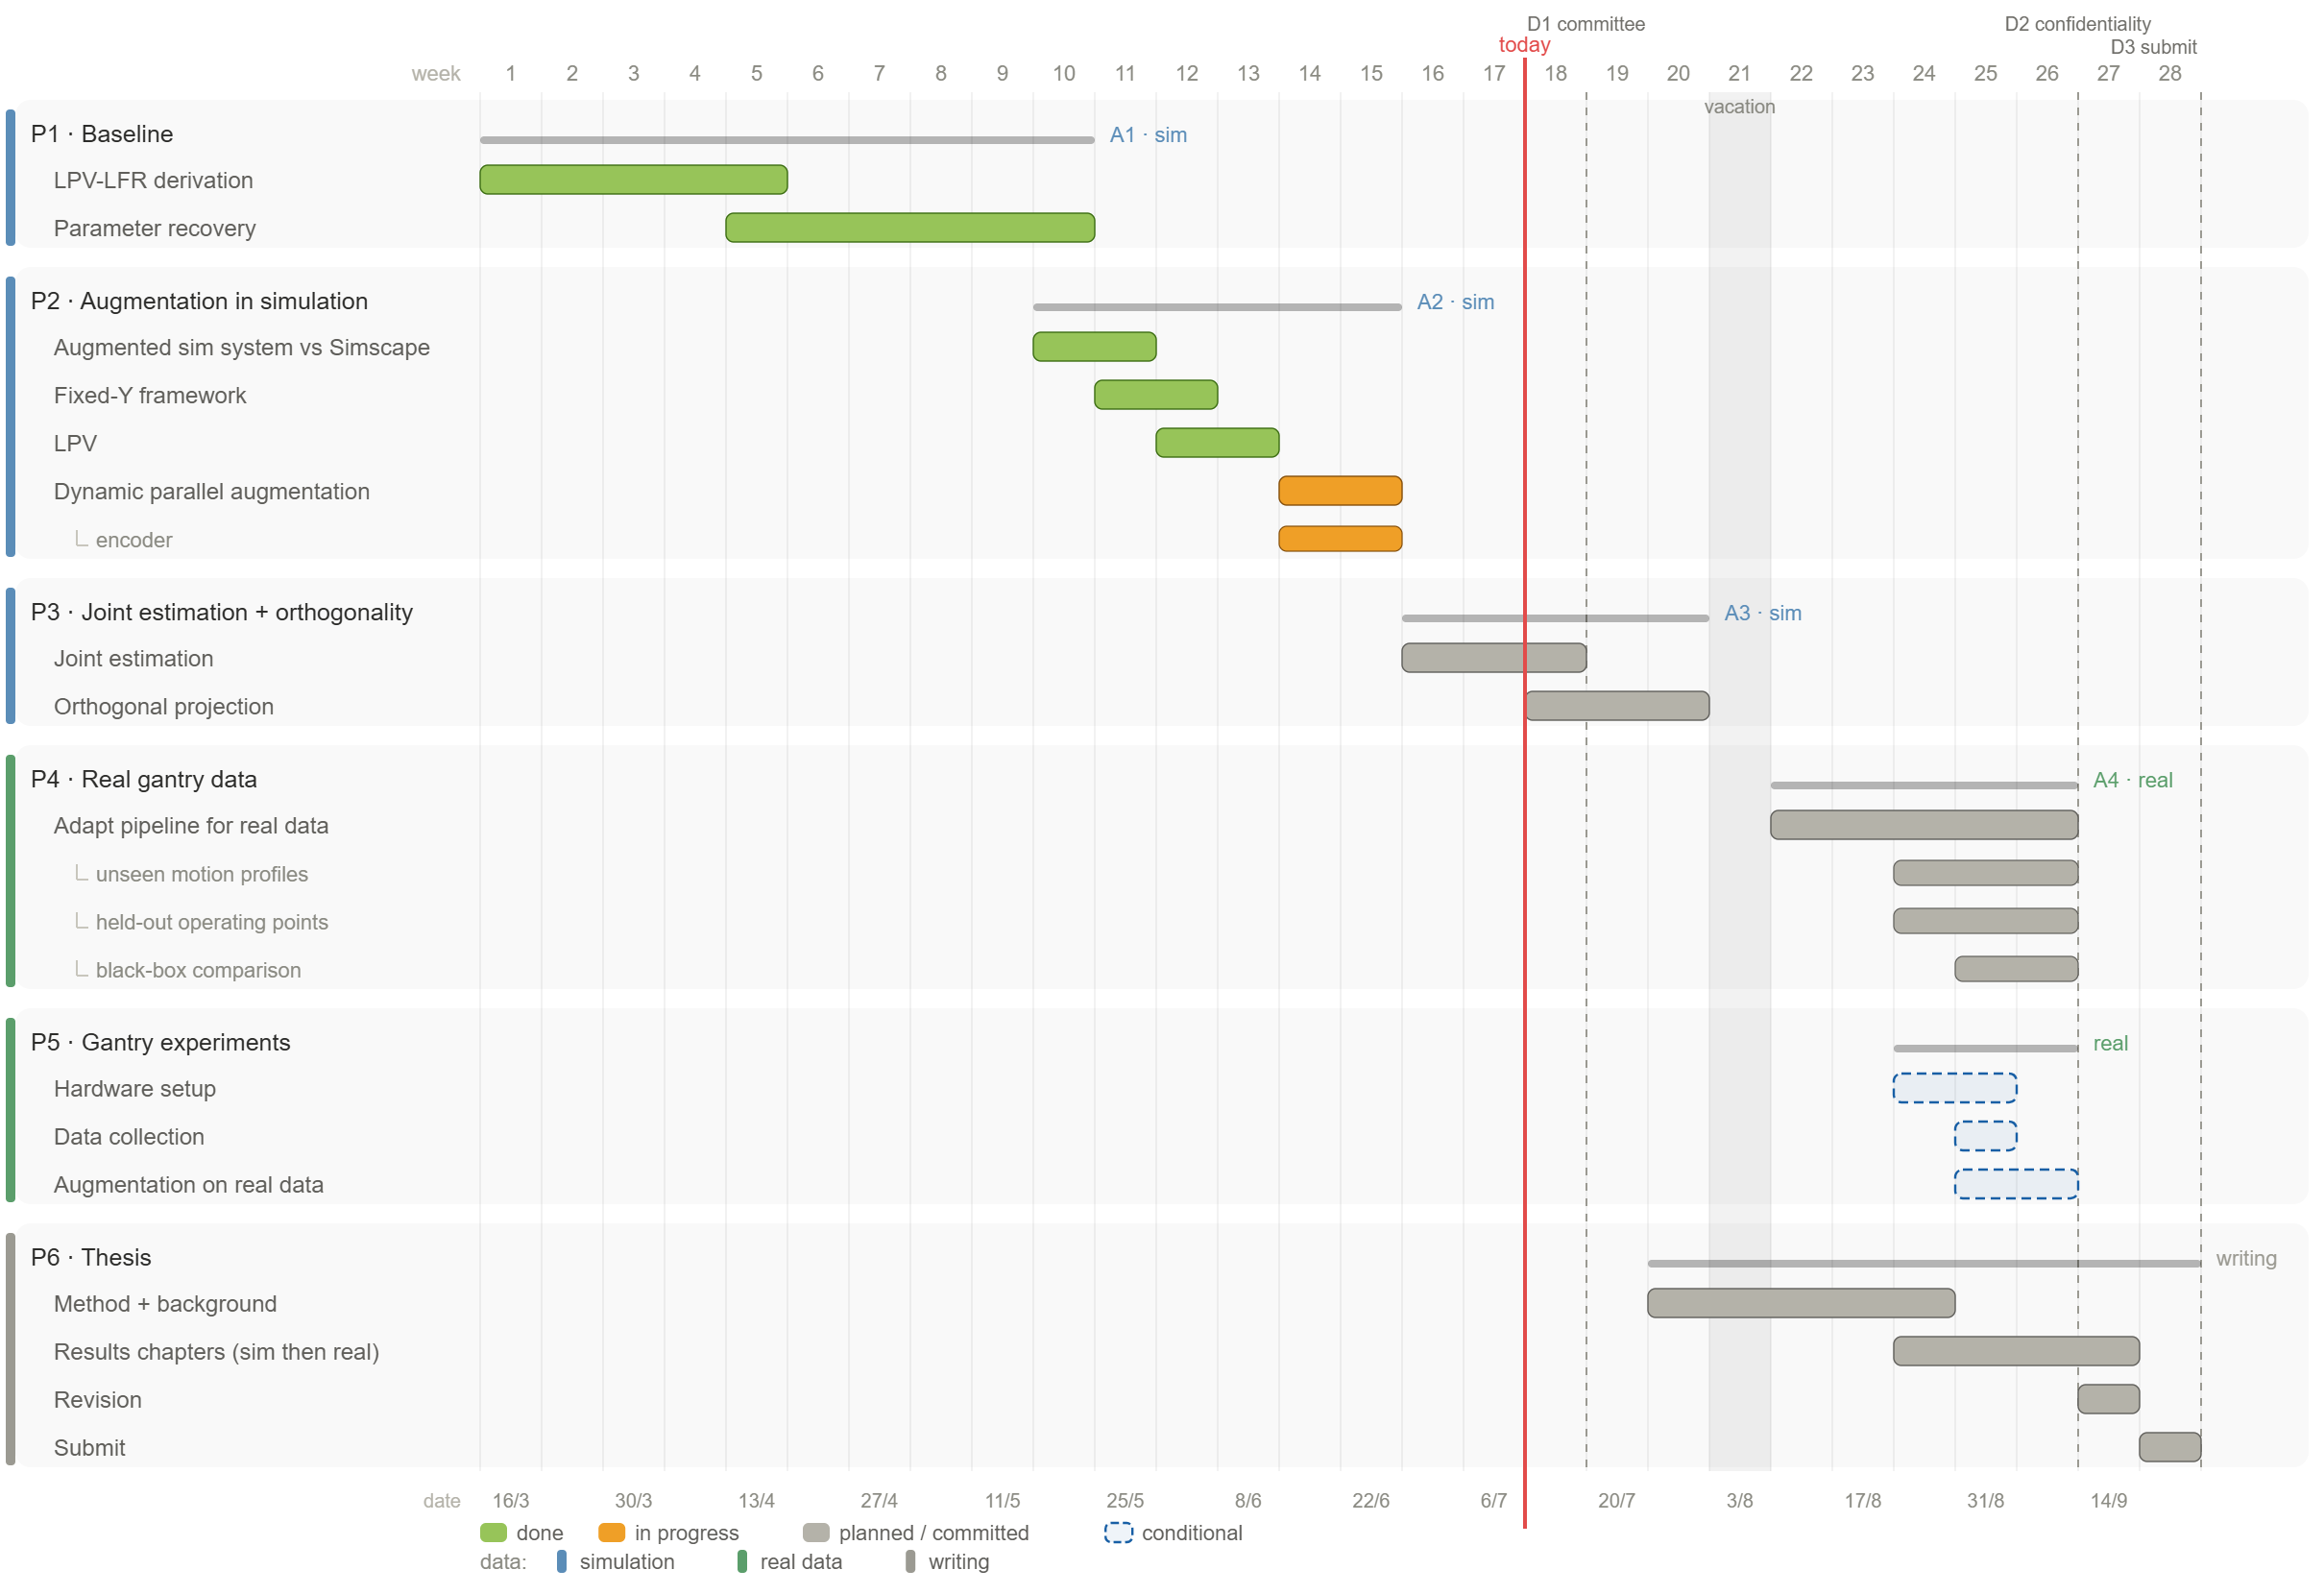

Slide 44
but about X having viscous damping. then we would still exspect that the drift damps out right? my supervisor gave the example of we have a car we push it, nothing will decrease the energery, but we have the damping on X, so we should not see this unbounded behaviour.UserPromptSubmit hook timed out after 5s — output discarded. Raise the hook's "timeout" to allow more time.UserPromptSubmit hook errorFailed with non-blocking status code: 0 [main] bash (13060) C:\Program Files\Git\bin\..\usr\bin\bash.exe: *** fatal error - add_item ("\??\C:\Program Files\Git", "/", ...) failed, errno 1This is the crux of the supervisor's objection, and it deserves a precise answer, because the car example is actually correct for one case and the resolution is which case the ANN is in.The car example is right for a one-time push, and the diagnosis already relies on itPush a car once and let go, with damping present:M ẍ + c ẋ = 0, initial velocity v0 → ẋ = v0 e^(−t/τ), x → x0 + v0·τ (BOUNDED)The car coasts to a stop; damping settles it to a finite offset v0·τ. This is exactly d2's measured result: a one-time initial-velocity error (from the encoder) leaves the bounded offset τ·dv, and the true model does not drift. So the supervisor's intuition is physically correct, and our own diagnostics confirm it for a transient disturbance.But the ANN is not a one-time push, it is a stuck throttleThe trained ANN applies a persistent force, near-constant every single timestep (d8: dY row |mean|/rms = 0.997, essentially pure DC; d6: removing it cuts drift 133×). For a constant force F:M ẍ + c ẋ = F → ẋ → F/c = v_ss (constant, nonzero), x(t) → (F/c)·t (UNBOUNDED)Damping does not stop this. It brings velocity to a steady state (terminal velocity v_ss = F/c), not position. This is a car with the throttle held down against air drag: it reaches top speed and then cruises forever. Distance travelled is unbounded even though the speed is constant and finite. The damping is fully active the whole time; it just balances the force at a nonzero cruising speed instead of at rest.So the difference is not "damping vs no damping," it is transient push vs persistent push. The car example bounds the first; the ANN is the second.The energy argument, made precise, actually confirms thisDamping does dissipate energy here. But the persistent force keeps pumping energy in. At terminal velocity the two balance exactly:power in = F·v_ss = c·v_ss² = power dissipatedIt is a steady state with bounded kinetic energy and constant velocity, yet unbounded position. "Energy is removed" therefore implies "velocity/kinetic energy bounded," not "position bounded." That is the passivity fact throughout the docs: damping bounds velocity, never position on a spring-free axis.It is not instability, and no amount of damping can fix itThe characteristic polynomial of the X axis is M s² + c s = s(M s + c), with poles at s = 0 and s = −c/M. Damping only sets the second pole (the velocity mode, stable). It cannot move the pole at the origin — that is the free integrator, the position mode. A DC force fed through a pole at the origin integrates to a ramp. This is not an instability (nothing in the right-half plane, no exponential blow-up); it is a marginal pole excited by a persistent input, giving linear/quadratic growth, not e^(αt). The only way to move the origin pole into the left-half plane is to add a k·x term (a spring): M s² + c s + k has both poles with negative real part and x_ss = F/k bounded. There is no spring on X or Y (the _K4 X/Y rows are zero), so nothing bounds position.This is also why the supervisor's "discretisatie op de rand van stabiliteit" is worth a clean check but is a different effect: the origin pole is marginal by construction (K=0), and the drift we measure is the forced response of that marginal pole to the ANN's DC, not a discretisation that pushed a pole outside the unit circle. Worth confirming with the discrete eigen-check, but the ramp is explained without it.---Summary- The car example is correct for a one-time push: damping settles it to v0·τ (bounded), which is exactly what d2 measures for the true model, no drift.- The ANN applies a persistent DC force (d8: 0.997 pure DC), which is a stuck throttle: damping sets a nonzero terminal velocity F/c, and position ramps forever. Damping bounds velocity, not position.- Poles are s(Ms+c) → one at the origin (free integrator) that damping cannot move; only a spring (k>0) would bound position. There is no spring on X/Y.- So it is not instability and not a missing-damping problem; it is a persistent force through a marginal (origin) pole. That is why the fix targets the ANN's DC, not the damping.

Slide 45
❯ but why could the ANN not be able to create a stiffness? and can it also route to the off diagonal matrix positiosn?Let me verify the routing semantics in the model builder before answering the off-diagonal question precisely. Searched for 1 pattern, read 1 fileGood, I've confirmed the wiring in model.py. The ANN reads the full state plus u and its output is added to the state-derivative (ẋ) at the rows named in route_ix; it does not write to the M/C/K matrix entries. That answers both questions precisely.Q1: The ANN can represent a stiffness. The issue is it isn't driven to, and we wouldn't want to force itArchitecturally the ANN is a function F(x, u) and it reads position (positions are in x). So it can output a force proportional to position, which is exactly a stiffness −k·x. Nothing forbids it. So the honest answer to "why can't it" is: it can. The reasons the drift persists anyway are three, and they matter:1. The loss never asks for it. On the K=0 axes the low-frequency / DC force direction is unexcited and loss-neutral in the 0.1 s window (d12). The training loss cannot see the position running away (it enters the RMS only past ~0.5 s), so there is no gradient rewarding the ANN for developing a restoring force. It has no reason to learn a stiffness even though it could.2. We would not want to hard-code one either, because it is the wrong physics. The true X/Y axes are free integrators (|λ| = 1). A stiffness moves that pole inside the unit circle (|λ| < 1) and invents a spring the real system does not have. That violates R3 (marginal-mode preservation) and would be "two wrongs": cancelling a spurious DC by inventing a spurious restoring force. It might bound the sim while modeling the wrong system, and it fails the R3 eigen-check. The expressivity principle cuts both ways: we must leave the ANN free to learn a genuine stiffness if real data ever shows one, and equally must not manufacture one where the data is silent. Forcing a stiffness assumes physics the data never demonstrated.3. Even mechanically a learned stiffness is a weak bound. A neural net is a bounded, local function fit on a bounded region of state space. A real position bound needs a restoring force that keeps growing as x grows (−k·x unbounded). During a large drift excursion the state leaves the training region, where the ANN extrapolates unreliably, so it cannot be trusted to keep pulling back. It cannot guarantee a bound even if it tried.So the drift is not a "missing stiffness" problem. It is an "unconstrained low-frequency force direction" problem: the loss leaves the DC on those axes undetermined, so the ANN wanders into an arbitrary one and the integrator amplifies it. The correct fix removes/pins that DC (Layer 2, or the encoder-init fix upstream), so no restoring force is needed, rather than adding a fake spring.Q2: The ANN does not write matrix entries, but it can produce effective off-diagonal couplingMechanically, the ANN adds a force vector to ẋ at the routed rows (route_ix). It never edits M, C, or K. So "routing to an off-diagonal matrix position" is not literally what happens. But functionally it can create off-diagonal coupling, because it reads the full state and writes to a chosen row:- ANN force on the X row proportional to Y position = an effective off-diagonal stiffness K[X,Y].- ANN force on the X row proportional to Y velocity = an effective off-diagonal damping C[X,Y].- ANN force on the X row proportional to θ = X–θ coupling, and so on (including nonlinear, Y-scheduled versions, since it reads Y).So the ANN can represent any (nonlinear, state-dependent) off-diagonal coupling among the states it reads and the rows it writes to. Two knobs:- Which output rows it can affect = route_ix (currently 0..7, the full X+θ+Y set).- Which states the force may depend on = always the full state (["x","u"]).Together, the effective "matrix" the ANN adds on top of the baseline can be full, off-diagonals included, limited only by which output rows are routed. This is exactly why X and Y must stay in the routing (D-103): the cross-axis and absorber coupling cannot be represented without X/Y as output rows. It reinforces the point above: the drift is not caused by any routing or expressivity limit (the ANN can already do both off-diagonal coupling and a stiffness). It is caused by the loss not constraining the DC on the free-integrator axes.---Summary- The ANN can build a stiffness (it reads position), so capability is not the limit. It doesn't, because (1) the windowed loss is blind to the drift so nothing rewards a restoring force, (2) a stiffness on X/Y is wrong physics (moves the marginal pole, breaks R3, a fake spring cancelling a fake DC), and (3) a local NN can't extrapolate an unbounded restoring force anyway.- The ANN never edits M/C/K; it adds a force to the routed ẋ rows. But reading the full state and writing to chosen rows lets it create effective off-diagonal coupling (cross-axis stiffness/damping/LPV terms) — which is exactly why X/Y are in the routing.- So the drift is an unconstrained-DC/identifiability problem, not a routing or expressivity gap. The fix is estimator-side (pin the DC / fix the encoder init), not making or forcing a stiffness.

Slide 46
Routing S
---Summary- The routing connects signals: expansion_matrix is a 0/1 scatter that places each ANN output into a chosen ẋ row; it is fixed and linear, not learned, and acts on the ẋ vector, not on M/C/K.- It can target any/all nxd derivative rows (currently all, 0..7); coupling/off-diagonal/stiffness effects come from the ANN reading the full state, so with full routing + full-state input every effective-Jacobian entry is reachable.- But it is a parallel additive residual, not an edit of the baseline physical matrices (those stay intact for interpretability). So reaching "all indices" is functional, via the residual path.- Therefore the drift is an identifiability/loss problem, not a routing/expressivity limit, consistent with the earlier answers.

Slide 47
Unexcited null-direction
identifiability framing: drift along an unexcited null-direction, cured by a null-space prior

Slide 48
Orthogonality
“The original approach has been derived for feedforward control, but it can be easily modified for system identification problems if the FP model can be represented as being linear in the parameters”

Slide 49
ZOH issue
Resampling issue, did not average over the resampled values…

Slide 50
Ask jan advice about normalization (anti aliasing) for velocity states
  I don’t have velocities saved
  I used finite difference
  But when adding noise should I do…
  For simulation maybe just keep easy for now since we know the true velocities.

Slide 51
The velocity rows the ANN writes to (dX, dY) carry a DC bias — |mean|/rms = 1.0 on dY means that channel is nothing but a constant offset. Adding a constant to a velocity state every step is exactly the persistent "force" that a free position integrator turns into drift.

Slide 52
Coulomb friction does not solve the issue?
So it's a useful real-data ingredient — but on its own it can't be the guarantee, because it doesn't remove the free-integrator nature or the training pathology

Slide 53
Dissipativite force
and where do we base this approach of?Honest provenance, separating bedrock, literature, and our synthesis — because this matters for the thesis.1. The core principle: classical passivity/dissipativity theory (bedrock, verified)The idea "constrain the added component to be passive → it can't produce energy → the interconnection stays bounded" is standard control theory: Willems (dissipativity, 1972), van der Schaft, Khalil's passivity chapter. The energy inequality ∫F·v ≤ storage and passive-interconnection stability are textbook. This is solid, decades old, not from the ML papers.2. The specific fit to our system: Negative-Imaginary free-body theory (verified)The reason passivity/NI is the right framework for our plant specifically: Negative-Imaginary systems theory, and critically its free-body extension — Mabrok, Kallapur, Petersen & Lanzon, "Generalizing Negative Imaginary Systems Theory to Include Free Body Dynamics," IEEE TAC 2014 (arXiv:1305.1079). It's built for exactly force-to-position colocated mechanical systems with poles at the origin (free-body/integrator modes), and it admits up to two poles at the origin. I verified this at the source. It's the only classical framework native to our marginal case.3. The neural realization: the parametrization machinery exists, but forces strict stabilityHow to make a neural network passive/dissipative: Recurrent Equilibrium Networks (Revay-Wang-Manchester, arXiv:2104.05942), dissipative/passive neural ODEs (Cheng et al. 2404.12554), KYP-projection nets (Okamoto-Kojima 2408.11479). I verified RENs: passivity is available but bundled with strict contraction (PD storage), which excludes the marginal (integrator) mode. Same for the others — they force strict positive-definite storage for trainability. So they give the machinery but not our case as-published.4. The gap = the contribution (our synthesis, not a citation)The precise object we need — a positive-SEMIdefinite-storage passive/NI neural block (storage flat along the rigid-body coordinate → pole stays at the origin) — is exactly what the neural constructions regressed away (they use strict PD). The deep-research survey flagged this as a genuine gap, a synthesis of building blocks, not a citable result. So the passivity-constrained-ANN-that-preserves-the-marginal-mode is our contribution, based on classical NI theory + the neural parametrization literature, but not itself published.5. Friction specificallyFor the nonzero-at-rest dissipative friction: maximal-monotone / set-valued operator nets (Combettes-Pesquet-style monotone nets; constrained-monotonic nets) and recent "dissipative neural networks" (arXiv:2509.09899) — dissipative F·v ≤ 0 by construction, nonzero at rest. These are agent-reported/unverified — leads, not confirmed.Verification honesty- Verified at source: classical passivity/NI (Mabrok 2014 free-body), RENs forcing strict PD (excludes marginal), Györök 2026 contraction (our framework, excludes marginal).- Agent-reported/unverified: the 2025/2026 dissipative-NN and maximal-monotone friction-net papers, and the "semidefinite storage" nonlinear-NI definition (Ghallab-Petersen). Verify before thesis use.- Our synthesis (unbuilt): the marginal-preserving passive neural block itself, and the bounded-integral trick we built (deep-research self-flagged as synthesis).All of this is recorded in docs/drift-diagnosis-status.md §5b (the construction) and §9 (the verified/unverified literature map).Summary- Bedrock: classical passivity/dissipativity (Willems/van der Schaft/Khalil) + NI free-body theory (Mabrok et al. 2014, verified) — the classical framework for force-to-position systems with integrator poles.- Machinery: neural passivity/dissipativity constructions (RENs, dissipative NODEs, KYP) — but all force strict stability, excluding our marginal mode.- The gap = the contribution: a positive-semidefinite-storage passive/NI neural block that preserves the integrator — our synthesis, not a citable method.- Friction: maximal-monotone/dissipative nets (agent-reported, unverified).- Documented in §5b / §9, with verified-vs-unverified flags.So the approach rests on solid classical passivity + NI free-body theory, uses existing neural-passivity machinery, and its novel piece (marginal-preserving) is the contribution — not something we're taking on faith from an unverified paper. Want me to verify the two load-bearing unverified pieces next (the semidefinite-storage nonlinear-NI definition, Ghallab-Petersen; and a maximal-monotone friction net), since those are what the friction-capable version leans on?

Slide 54
❯ and how does this extend to real nonlinear data where we dont know the model exactly?Recorded in §5e.2 (cross-coupling hard constraints + the bound's status). Now the new question, which is the deeper one: does this MIMO-integral-passivity reasoning survive on real data where we don't know the model?The honest answer: the constraint transfers cleanly, but one assumption becomes unverifiableLet me separate what's knowledge-free from what relied on knowing the sim model.What transfers cleanly (knowledge-free):- The MIMO integral passivity constraint itself is a structural property of the ANN block — it holds regardless of the true dynamics. You enforce ∫(F_X·v_X + F_Y·v_Y) ≤ storage by construction; it needs no model. So on real data, the constraint forbids drift and allows cross-axis transfer exactly as on sim. ✓- Passivity is the right frame precisely because real systems are passive. A real mechanical stage (masses, dampers, friction, cross-coupling) is a passive physical system — it can't produce net energy. So whatever the unknown real coupling is, it's passive, and a passive ANN can represent a passive residual. This is the deep reason the approach is more robust on real data, not less: you're imposing a property the real system genuinely has.What becomes unverifiable (the assumption I used):- On sim I checked "the true X+Y coupling is net-dissipative" using D-A (which computes truth − baseline — needs the known model). On real data there's no truth, so I cansidual is passivity-compatible. I'm relying onthe physical argument (real systems are passive) instead of a measurement.- The risk this creates: if the real residual has a component that is not representable as a passive force w.r.t. the (X,Y)collocated pair — e.g. energy entering X/Y fromconstrained pair (Θ, or an unmodeled resonance)— then MIMO-X/Y passivity could be too tight and refuse it, leaving a bounded error. On sim I could check X+Y was net-dissipative; on real data I can't, so I'd only find out from the fit residual.So the honest position for real data - The constraint is knowledge-free and physically well-motivated (real stages are passive), so it should hold and prevent drift without knowing the model — that's the whty over a model-based fix.- But "can the passive ANN represent the real coupling" cannot be pre-verified on real data (no truth). You verify it empirically, post-fit: does the passivity-constal free-run well, or does it leave a systematicresidual (a sign the constraint is too tight)? That's the real-data analogue of D-D1.- Scoping caveat that matters more on real data: because energy can flow from unconstrained axes (Θ, unmodeled modes) into X/Y, the safe choice may be to make the passiviaugmented output (X, Θ, Y, δ_a) jointly, or atleast verify the X/Y pair is closed enough. This is a design decision to settle on the injected-friction sim first (where we can check), then carry to real data. How you'd actually validate it on real data (no model) 1. Fit the passivity-constrained augmented modea.2. Check free-run fidelity (BFR) on held-out real data — is it bounded and accurate? (drift gone = constraint working; large systematic residual = constraint too tight). 3. Energy audit on the fitted model's free-run:ill, by construction) — and check the residualisn't concentrated where the constraint bites.4. Compare against the bounded-integral and Coulomb-in-f_base versions on the same real data — the one with lowest held-out free-run error wins.Summary- The MIMO-integral-passivity constraint transfers to real data knowledge-free — you enforce it structurally, no model needed, and it prevents drift + allows cross-coupling exactly as on sim.- It's actually well-suited to real data because real stages are passive — you're imposing a true physical property.- What you lose: the pre-check that the residual is passivity-compatible (D-A needs the model; no truth on real data). You verify that post-fit (held-out free-run fidelit- Sharpened risk for real data: energy inflow from unconstrained axes/modes (Θ, resonances) could make X/Y-only passivity too tight → the safe design may span the whole augmented output; settle this on the injected-friction sim (where you can check), then carry over.So it extends to real data as a constraint cleanly and is the right physical frame, but "can it represent the real coupling" is only verifiable empirically after fitting — ant me to record this real-data extension(constraint transfers knowledge-free; representability only post-fit-verifiable; possibly widen the constraint to the whole augmented output) in the doc alongside §5e.2?

Slide 55
port-Hamiltonian construction
why are we using port-Hamiltonian construction and not for example euler lagrange?Good question, and worth answering properly. Let me address it while the audit finishes (its output is buffered, so it will land all at once when the process exits; I'll report it then).Why port-Hamiltonian and not Euler-LagrangeShort version: for a mechanical system the two are essentially equivalent (related by a Legendre transform, H = pᵀq̇ − L), so it is not that Euler-Lagrange (EL) can't express this. The point is that port-Hamiltonian (PH) is EL already rewritten into the coordinates that expose exactly the three things we need to constrain and certify: a power port, a storage function, and native dissipation. With EL you would have to transform to the Hamiltonian anyway to get the energy certificate. Concretely:1. We need a port with a passivity certificate on the (F, v) pair, and PH is built around exactly that. PH's native objects are the power-conjugate pair (effort F, flow v), a storage H, and the supply rate Fᵀv. Passivity is one line: dH/dt ≤ Fᵀv. The constrained parametrization (J skew, R ⪰ 0, H ≥ 0) gives it by construction. EL's native object is d/dt(∂L/∂q̇) − ∂L/∂q = τ, which does not expose a port or a supply ratto certify passivity, i.e. convert to PH.2. EL forces a position potential V(q); that is exactly the stiffness fork 2 forbids. In EL, energy storage lives in L = T(q̇) − V(q), so storage that is not purely kinetic is a potential in the configuration q = a spring on q. On our free X/Y axes a potential in the machine position moves the pole off the origin (violates marginal preservation, A3). PH lets storage live in the block's internal states ξ via H(ξ),ion, so we get spring-like storage and stillread only velocity at the port. This alone is close to decisive.3. Dissipation and friction are native in PH, bolt-on in EL. EL is conservative by construction; dissipation enters only viaan added Rayleigh function and is not part of t whole R3 point) is dissipative and, for LuGre, nonsmooth with an internal bristle state. PH has R ⪰ 0 built into the structure and the passivity proof, and LuGre is standardly a passive/PH operator with a bristle state that maps directly onto our ξ (§5h). So the nonlinear friction case isa config change in PH, not a re-derivation.4. Interconnection compositionality (needed for the augmented-system theorem, A2). We are adding this block to an LFRinterconnect. PH systems compose: a power-preseive subsystems is passive. That is precisely the machinery for "baseline (passive) + passive ANN → bounded augmented interconnection." EL has no comparable native interconnection algebra.5. Neural recipes and semidefinite storage. Learnable PH / dissipative-node parametrizations (J skew, R PSD, H a nonnegative net) are established and give passivity by construction. Neural-Lagrangian networks (Lagrangian NNs) exist but are builtfor energy conservation (no dissipation) and woboth friction and the port/passivitycertificate. And we specifically want positive-semidefinite storage (flat along the rigid-body coordinate, pole at origin) which is natural to state on H, awkward on V(q).Honest note on consistency with the truth model. The plant data is generated in Lagrangian/EL form (gantrySystemExtended.m, additional_state_lagrangian.m: Mq̈ + Cq̇ + Kq = f). That is fine and not a conflict: the absorber is a passive ELmass-spring-damper, and every passive EL subsysthe PH block can represent the EL-generatedpassive dynamics; we just choose the PH form for the augmentation block because it is the one where the constraint we care about is structural and the certificate is one line.Bottom line: PH and EL are equivalent for mechanics, but PH is the frame where our exact requirements (a certified passive F-v port, storage in internal states rather than a machine-position potential, native dissipation for friction, and passive interconnection) are all structural rather thanrage into a position potential, which is thevery stiffness we must keep off the free X/Y pole.
Short version: for a mechanical system the two are essentially equivalent (related by a Legendre transform, H = pᵀq̇ − L), so it is not that Euler-Lagrange (EL) can't express this. The point is that port-Hamiltonian (PH) is EL already rewritten into the coordinates that expose exactly the three things we need to constrain and certify: a power port, a storage function, and native dissipation. With EL you would have to transform to the Hamiltonian anyway to get the energy certificate. Concretely:

Slide 56
Full sweep is in, and it settles the question cleanly:dt0 = 1.25e-4 : rel=1.176, max_r_rest=5.593e-8dt0/2 = 6.25e-5 : rel=0.539, max_r_rest=2.447e-8dt0/4 = 3.125e-5: rel=0.221, max_r_rest=9.585e-9dt0/10 = 1.25e-5 : rel=0.051, max_r_rest=2.186e-9The absolute violation falls monotonically toward zero as Δt→0 (slope ~1.4 in log-log), so this is a real discretization defect, not worst-num/mean-denom noise — which means my "maybe the metric is artifactual" hedge was wrong and the FAIL is genuine: explicit Euler at the pipeline Δt is not passivity-tight for the 150 Hz band (worst-case near-lossless weights create ~1.2× the energy they process over 0.1 s). The parametrization is structurally passive (the Δt→0 limit confirms it), but explicit Euler is the wrong integrator at the operating Δt.This matters for us specifically: on the full 12 s free-run the block's ξ is not re-seeded, so even a small per-step net injection would accumulate = exactly the drift we are trying to forbid. So we cannot accept an approximate discrete defect; we need the discrete passivity to be structural.The fix (flagged in doc §5i): a structure-preserving integrator. For the linear/quadratic H, the implicit midpoint rule with a midpoint force readout is exactly discrete-passive (Σ F·v Δt ≤ H(0)−H(T) with equality up to R, no Δt defect at all). I verified the discrete energy balance by hand: H(ξ_{k+1})−H(ξ_k) = Δt[−∇H_midᵀ R ∇H_mid − F_k·v_k], so the audit residual should drop to machine-eps. It is a cheap m×m (m=3) linear solve, fully differentiable for BPTT.Let me implement the midpoint integrator in the block (keeping Euler available so the audit shows the contrast), then re-run the audit.

Slide 57
Closed-loop alternative
Closed-loop simulation can hide bad model during training? Increase runtime
  But acceptable for ASMPT?
  Metrics for this:
  Reference papers
Options

Slide 58
Hoe laten zien dat de drift inherent is
Hoe bewijs ik dit?

Slide 59
Condition 1, universal and independent of our method: excitationNo method can learn dynamics the data doesn't excite. The real Telica data is fixed closed-loop logs; we cannot re-excite the machine. Content in genuinely unexcited directions is unlearnable from that data for any estimator — our penalty just makes the estimate in those directions explicitly minimum-norm instead of arbitrary. This is the limits doc's E1: class-free, but excitation-limited. "All dynamics" always meant "all dynamics the data carries information about."Condition 2, specific to Layer 2: the friction–DC collisionThis is the honest risk, documented since §5c and not yet resolved: real friction carries DC-like content, and Layer 2 pins DC-like directions. The concept's defense is that friction is velocity-dependent — under varied, direction-switching motion it produces informed, sign-alternating force content that the data defends, so the soft penalty vanishes there and only genuinely silent components get pinned. That argument is plausible and unproven, and d14 just taught us the loss-sensitivity structure is subtler than the concept assumed. Concretely where it can bite: data segments with monotone or one-directional motion, where Coulomb friction locally looks like a constant force — exactly the shape we pin. In that regime, an over-aggressive β or a badly derived cutoff would suppress real friction (the B1 bias-variance trade; the mistuning failure mode is explicitly on record).

Slide 60
and even for our real nonlinear data we will still be able to capture all dynamics?Honest answer: the model will remain able to represent all dynamics, but "capture" has two more conditions on real data, one universal and one specific to our fix — and there is one known collision we've deliberately left for a dedicated experiment.What is guaranteed: representabilityLayers 1+2 are estimator-side only. No dynamics class is forbidden, ever — that was the non-negotiable that killed the passivity/NI family. Whatever the real residual is (Coulomb, cogging, preload, unmodeled coupling), the ANN can express it. That part is safe by construction.Condition 1, universal and independent of our method: excitationNo method can learn dynamics the data doesn't excite. The real Telica data is fixed closed-loop logs; we cannot re-excite the machine. Content in genuinely unexcited directions is unlearnable from that data for any estimator — our penalty just makes the estimate in those directions explicitly minimum-norm instead of arbitrary. This is the limits doc's E1: class-free, but excitation-limited. "All dynamics" always meant "all dynamics the data carries information about."Condition 2, specific to Layer 2: the friction–DC collisionThis is the honest risk, documented since §5c and not yet resolved: real friction carries DC-like content, and Layer 2 pins DC-like directions. The concept's defense is that friction is velocity-dependent — under varied, direction-switching motion it produces informed, sign-alternating force content that the data defends, so the soft penalty vanishes there and only genuinely silent components get pinned. That argument is plausible and unproven, and d14 just taught us the loss-sensitivity structure is subtler than the concept assumed. Concretely where it can bite: data segments with monotone or one-directional motion, where Coulomb friction locally looks like a constant force — exactly the shape we pin. In that regime, an over-aggressive β or a badly derived cutoff would suppress real friction (the B1 bias-variance trade; the mistuning failure mode is explicitly on record).What stands between us and that failure1. The injected-friction experiment is the gate before real data (concept §9, the construction spec's Phase 3): inject known friction into the sim, train with Layer 2, and verify the ANN learns it while the drift stays pinned. If that discriminator fails, we do not proceed to real data with this configuration — that's precisely the test it exists for.2. The penalty is soft and the data wins where it pushes: informed content generates gradient against the penalty; only near-silent content yields.3. The documented fallback if the collision proves real: the grey-box route (§5d / Route A) — put a parametric friction structure (Coulomb/LuGre) into f_base so the physics carries the DC-prone part, and the ANN's residual is legitimately DC-free. That trades some model-class generality for a clean separation, and it stays on the shelf unless needed.So the truthful sentence is: on real data we keep full representability, we capture everything the excitation informs, and the single known threat to "capturing all dynamics" — friction content that mimics the pinned direction — has a pre-designed discriminating experiment before any real-data commitment, plus a documented fallback if it fails. What I won't claim is that the injected-friction gate is a formality; it's a genuine test, and it's the right order to run things in.

Slide 61
Telica data
Closed-loop runnen
Moet snel kunnen 2000 epochs of meer…?

Slide 62
Orthogonality only Theta

Slide 63
Three decisions I want your eyes on specifically:1. D7.5, theta_bar = the run's params_init, never the simulation truth. In the Stage C detuned-recovery test, the regularizer must be built from the experimenter's knowledge (the detuned init); building it at the true values would smuggle oracle information into the method and make the recovery result indefensible. This mirrors Gyorok's "theta_0 from datasheets."2. D7.6, loss scaling: the reference repo divides the penalty by batches-per-epoch; our Λ precedent adds per batch undivided. I follow our precedent (constant absorbed into the swept beta), which also means Gyorok's beta range is explicitly not transferable, only a bracket for the sweep.3. D7.1 placement in model_augmentation/ as an added file (vs keeping it in scripts/gantry/gantry_dynamic/). Rationale: it is generic augmentation machinery, and the added-file marker keeps ownership unambiguous per the CLAUDE.md tracking rules.

